Slide 1
Gene editing
The legal conundrums of this medical marvel
COPYRIGHT

Slide 2
Gene editing: a primer
Type of genetic engineering that modifies the genomic makeup of an organism
Early stages of this technology dealt with strictly micro applications:
  Cell biology
  Parasite biology
  Organism composition
COPYRIGHT

Slide 3
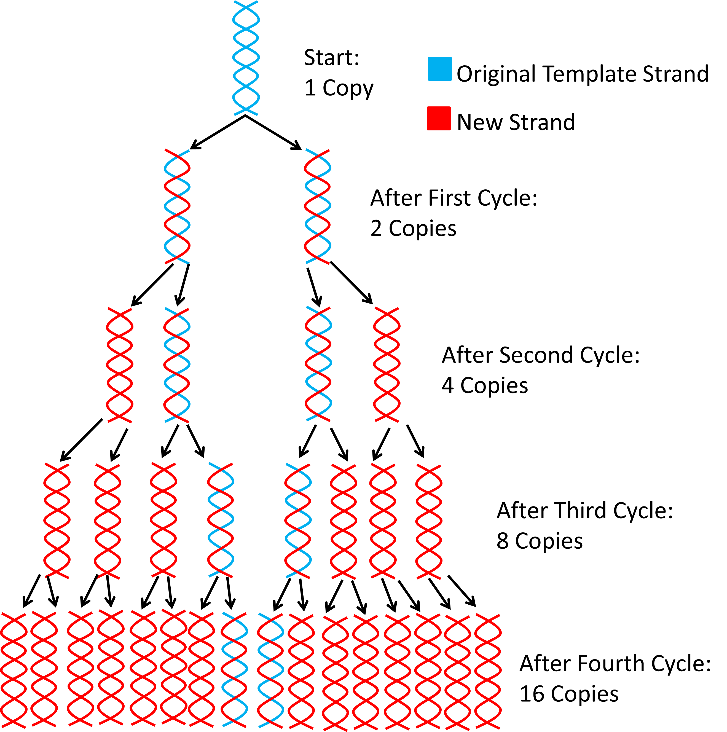
COPYRIGHT
Source: https://antisensescienceblog.files.wordpress.com/2013/12/exponential-inc2.png

Slide 4
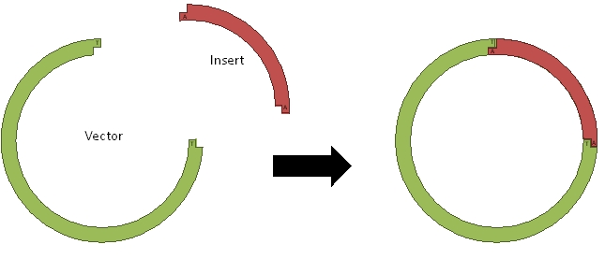
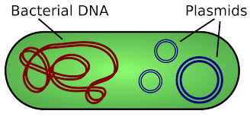
Source: http://www.di.uq.edu.au/sparq/images/proj4afig7.jpg
COPYRIGHT
Source: https://upload.wikimedia.org/wikipedia/commons/thumb/c/cf/Plasmid_(english).svg/2000px-Plasmid_(english).svg.png

Slide 5

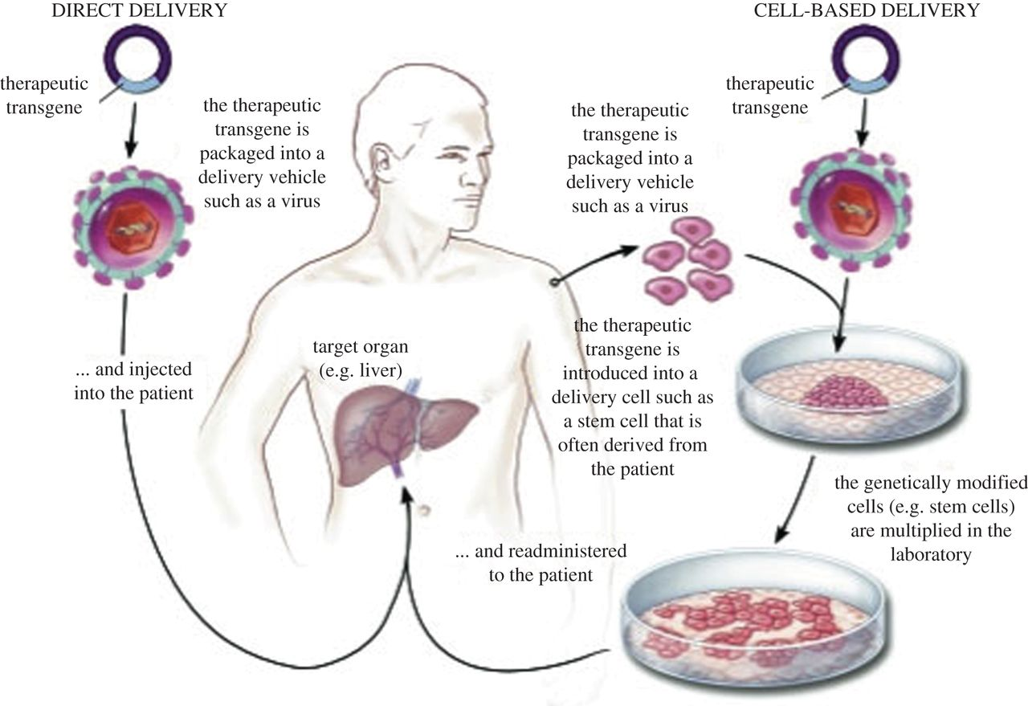
Gene editing: a primer
COPYRIGHT
Source: http://rspb.royalsocietypublishing.org/content/282/1821/20143003

Slide 6
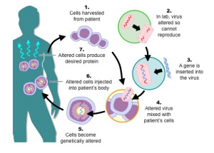
Gene Editing: a primer
Promise of future applications to medicine
Targeted genomic sequencing advanced this effort
Provides acute solution to chronic issues
COPYRIGHT
Source: https://medspanresearch.wordpress.com/2015/10/02/gene-therapy-the-price-is-right/

Slide 7
New frontiers
Embryological applications
Change “at will”/ cosmetic applications
Aim is to fix the problem at its source
Reactive vs. proactive
COPYRIGHT

Slide 8
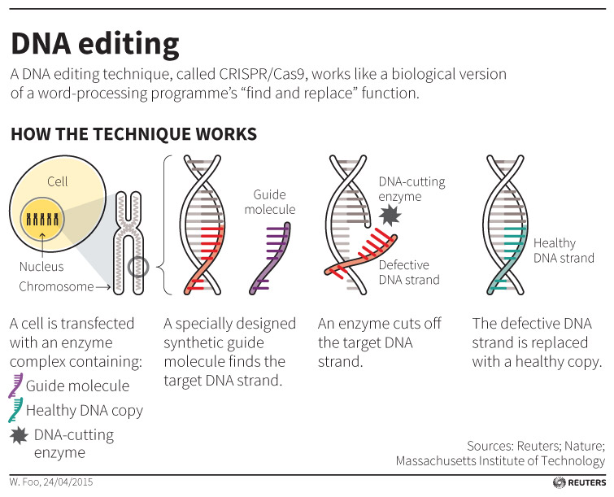
CrispR- Cas9 Technology
COPYRIGHT
Source: http://blogs.reuters.com/data-dive/files/2015/04/EditingDNA042715.jpg

Slide 9
New frontIErs
Privatization of the industry
Editas, Crispr Therapeutics, Intellia Therapeutics
COPYRIGHT

Slide 10

COPYRIGHT
Source: http://www.redherring.com/wp-content/uploads/2015/08/Editas.jpg

Slide 11
Legal conundrums
Reimbursement methodology
  Insurance?
  Cosmetic procedures?
COPYRIGHT

Slide 12
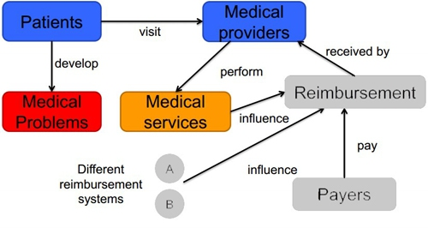
COPYRIGHT
http://www.anylogic.com/upload/medialibrary/087/0873b3d162433e69d5fcde5d9c62c9eb.jpg

Slide 13
Legal conundrums
Bioethics
  What is permissible?
  How far is too far?
COPYRIGHT

Slide 14
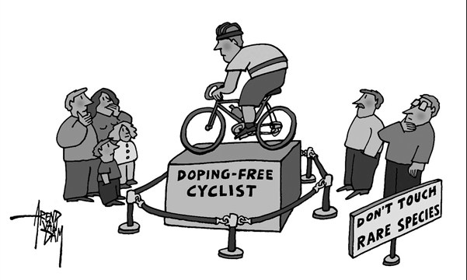
COPYRIGHT
Source: http://www.ilovebicycling.com/wp-content/uploads/2014/05/Screen-Shot-2014-05-25-at-11.21.51-PM.png

Slide 15

COPYRIGHT
Source: http://icons.iconarchive.com/icons/custom-icon-design/silky-line-user/512/male-female-icon.png

Slide 16
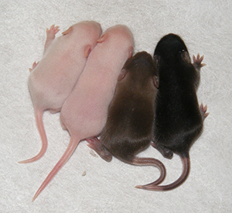
COPYRIGHT
Source: https://www.medicine.uiowa.edu/uploadedImages/Administrative_Units/Scientific_Affairs/Smart_Forms/CRISPR.jpg

Slide 17
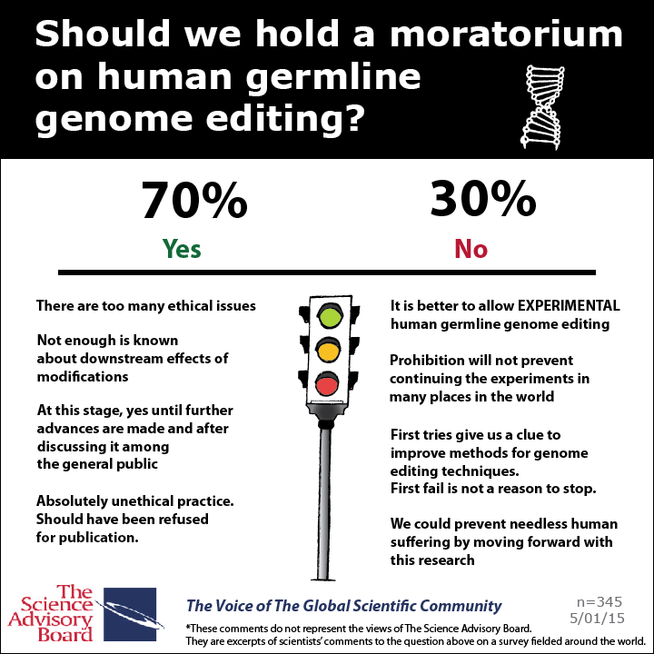
COPYRIGHT
Source: https://www.gene2drug.com/wp-content/uploads/2015/05/Moratorium-Human-Germline-Gene-Editing-720x720.png

